Slide 1
Domain Name
System

Slide 2
NAME SPACE
The names assigned to machines must be unique because the addresses are unique. A name space that maps each address to a unique name can be organized in two ways: flat or hierarchical.
Flat Name Space
Hierarchical Name Space

Slide 3
DOMAIN NAME SPACE
The domain name space is hierarchical in design. The names are defined in an inverted-tree structure with the root at the top. The tree can have 128 levels: level 0 (root) to level 127.
Label
Domain Name
Domain

Slide 4
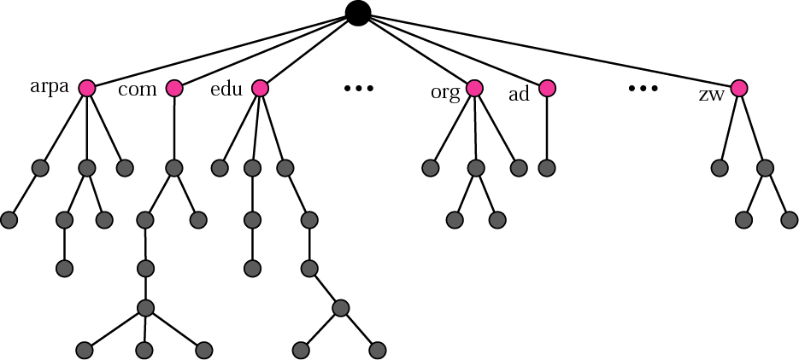
Domain name space

Slide 5
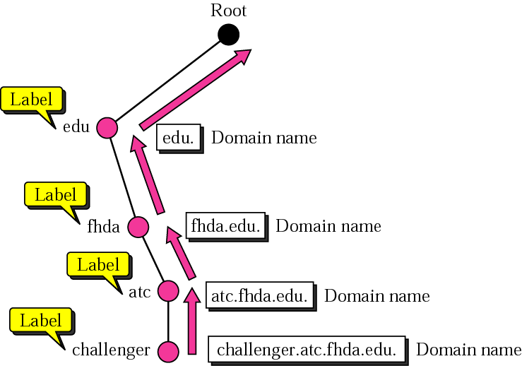
Domain names and labels

Slide 6
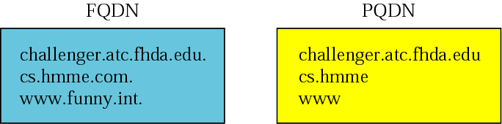
Figure 17.3 FQDN and PQDN

Slide 7
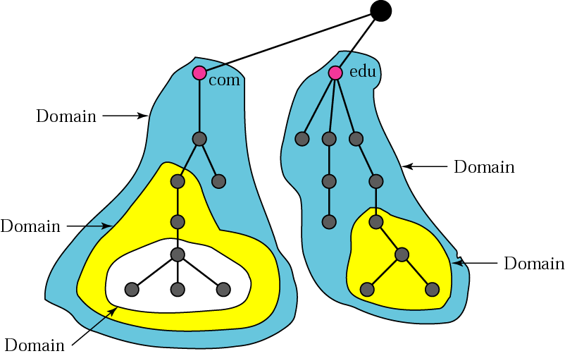
Domains

Slide 8
DISTRIBUTION OF
NAME SPACE
The information contained in the domain name space is distributed among many computers called DNS servers.
Hierarchy of Name Servers
Zone
Root Server
Primary and Secondary Servers

Slide 9
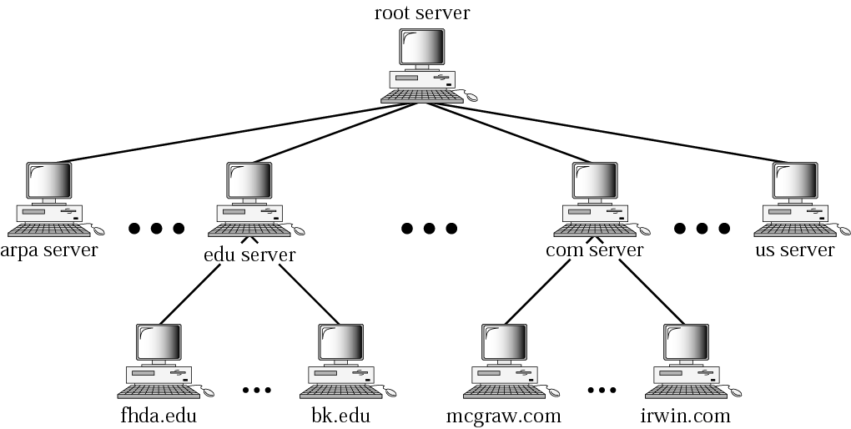
Hierarchy of name servers

Slide 10
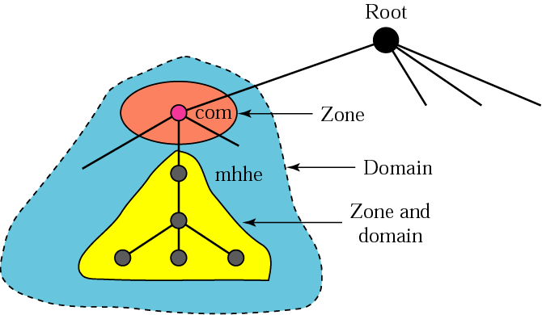
Zones and domains

Slide 11
A primary server loads all information from the disk file; the secondary server loads all information from the primary server. When the secondary downloads information from the primary, it is called zone transfer.

Slide 12
DNS IN THE INTERNET
The domain name space (tree) is divided into three different sections: generic domains, country domains, and the inverse domain.
Generic Domains
Country Domains
Inverse Domain
Registrar

Slide 13
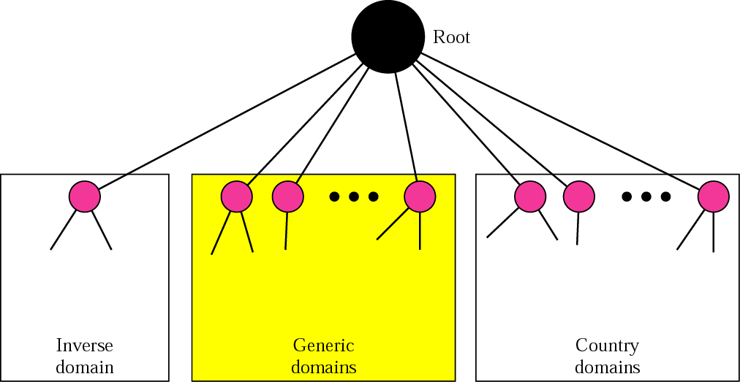
DNS used in the Internet

Slide 14
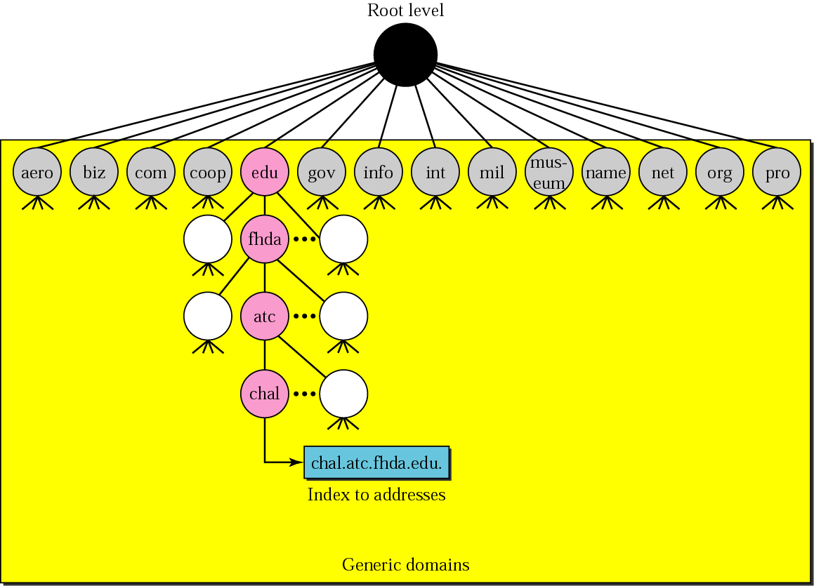
Generic domains

Slide 15
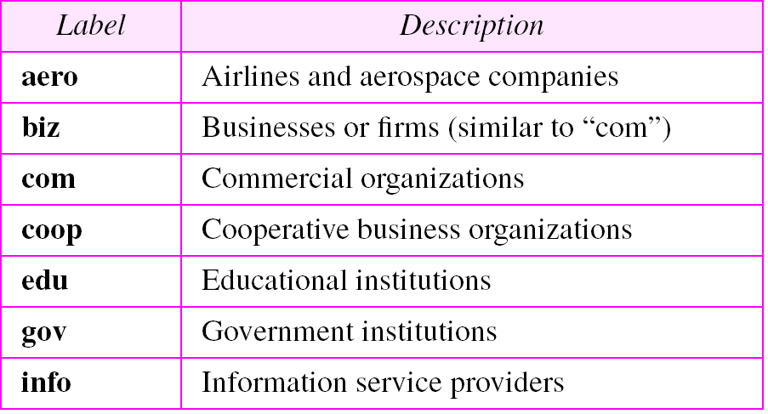
Generic domain labels

Slide 16
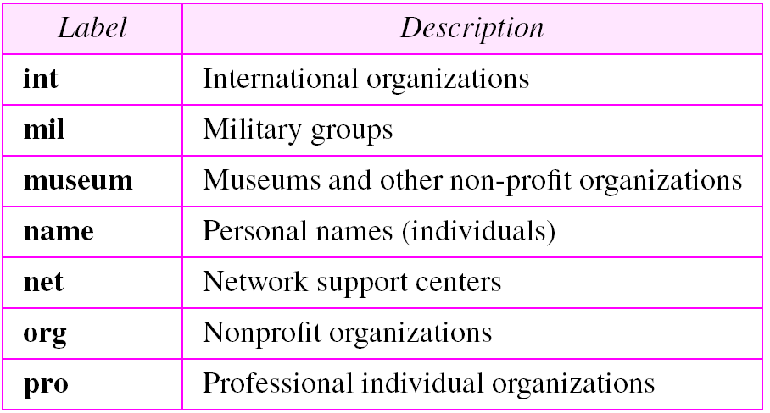
Generic domain labels (Continued)

Slide 17
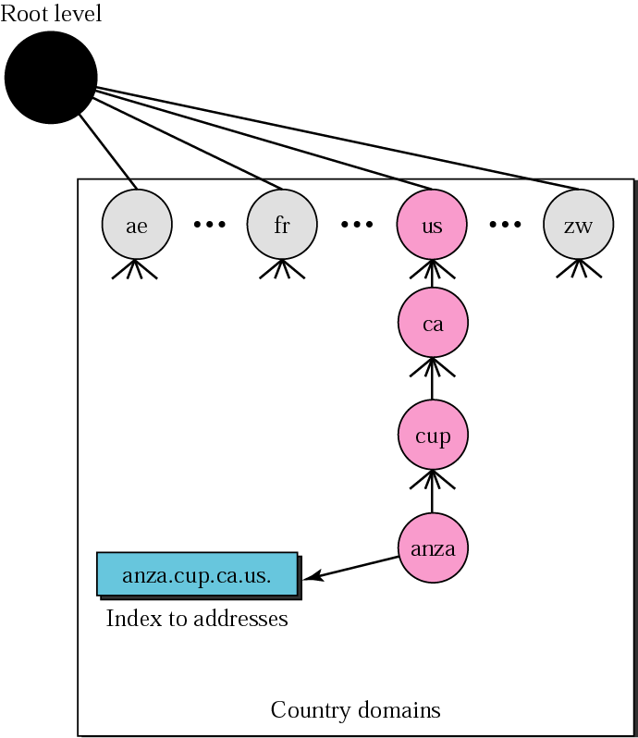
Country domains

